Slide 1
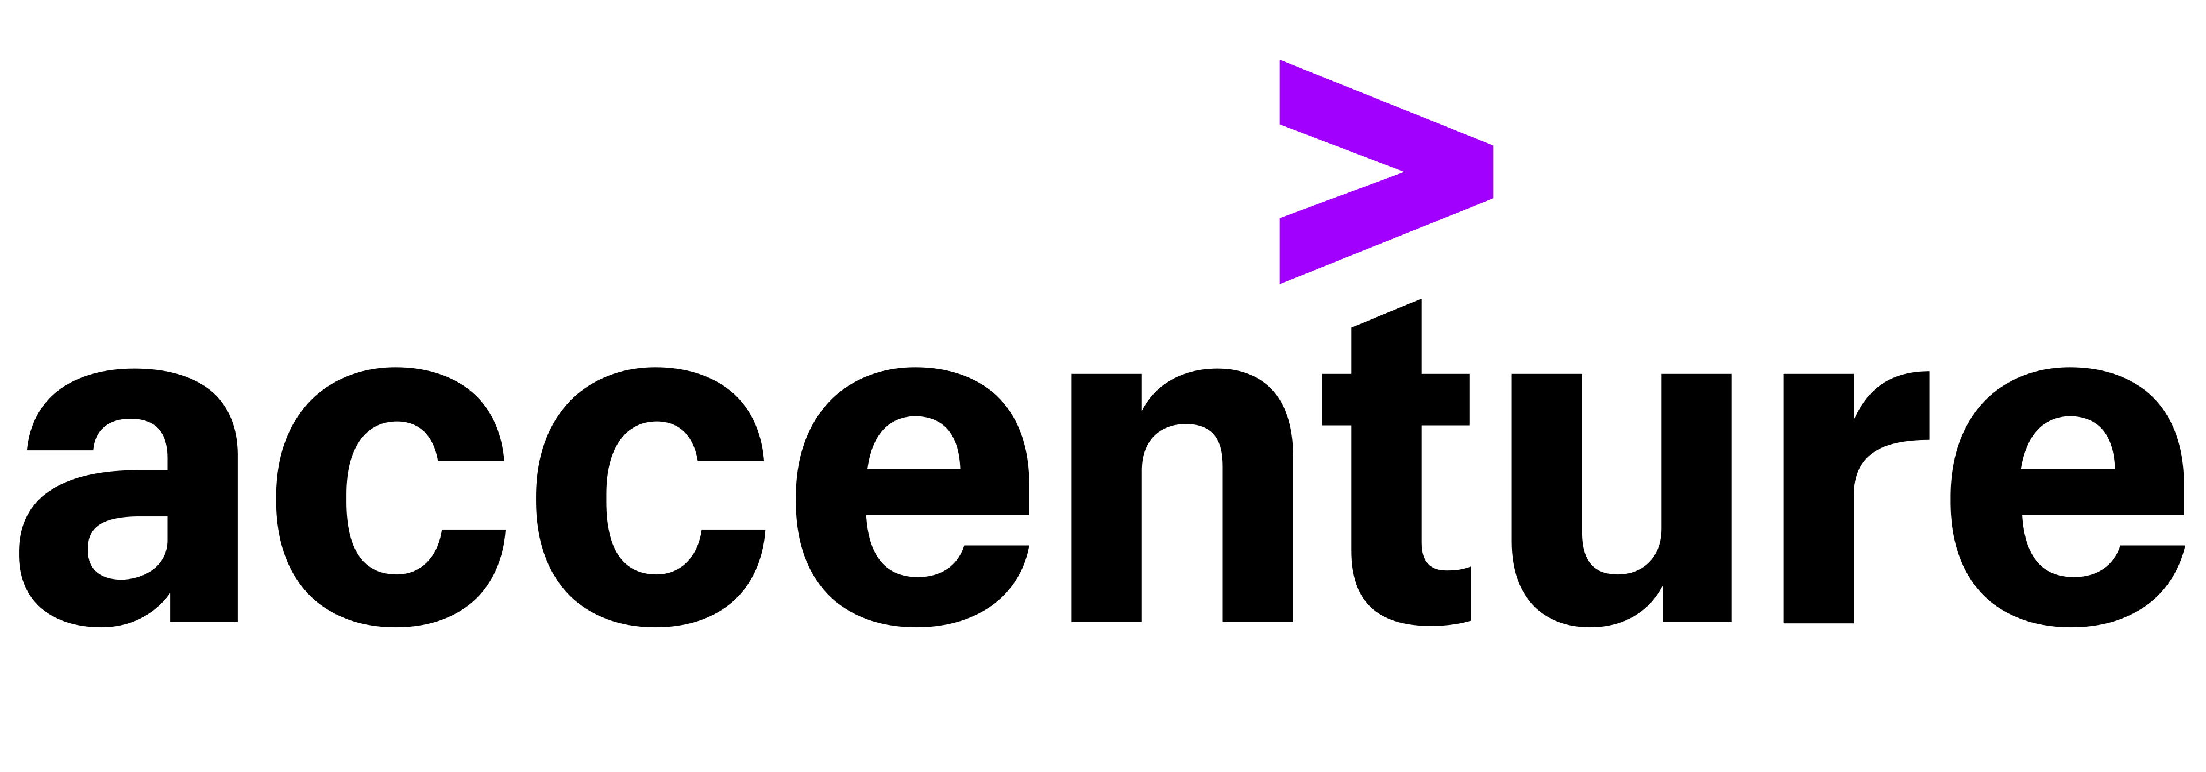
North Data Platform
Target State Blueprint
May 2026
Notes:
Graveyard slides are removed. To see the graveyard slides, refer to version 45

Slide 2
Table of Content
1
L1 Blueprints (Business Led)
2
L2 Blueprints (Builds on L1 by adding technology)
3
Enterprise Data Domains & Person Ontology
4
Enterprise Data Patterns

Slide 3
Table of Content
1. L1 Blueprints (Business Led)
Item | Description
1.1 NORTH Data Platform: Functional Architecture | Defines how Canada Life connects, governs, and delivers data as reusable products across business units to enable consistent insights, operational decisions, and AI at scale.
1.2 NORTH Platform Data Node FAQ | Addressing frequently asked question related to the Data Nodes within the NORTH platform.
1.3 NORTH Data Node Blueprint | Illustrate the data capabilities within a business‑owned space where data is managed and shared for reuse across the enterprise for analytical/operational data, and AI-Ready data.
1.4 Shared Services and Connectivity: Accessing Data Products Across Nodes | Illustrate how the NORTH platform provides secure, standardized connectivity that enables teams to discover and access data products across business data nodes, supporting enterprise reuse without creating silos.
1.5 360 Views Blueprint | Illustrate how 360 Views are assembled by combining mastered data from MDM with relevant business data nodes to support enterprise reuse and decision‑making.
1.6 360 Views — Illustrative Data Sourcing | Example of how data comes together into a 360 View within the NORTH Platform to enable a business insight/decision.
2. L2 Blueprints (Builds on L1 by adding technology)
Item | Description
2.1 Business Data Node (Architecture-Oriented) | A more detailed view of how structured and unstructured data is stored, processed, and accessed within a node.
2.2 Multi‑Cloud Architecture Blueprint | Illustrate how the end-to-end Data Strategy is delivered and enabled across multiple cloud platforms.
2.3 Shared Services and Connectivity: Cross‑Region Data Product Access | Illustrate how data products are securely stored and accessed across regions while respecting regional and regulatory requirements.

Slide 4
Table of Content
3. Enterprise Data Domains & Person Ontology
Item | Description
3.1 Enterprise Information Model – Domains | A shared business language used to classify, govern, and align data consistently across the enterprise.
3.2 Person – Canada Life Ontology Model | Defines the canonical representation of people and organizations, including their identities, relationships, and governance rules, across the enterprise.
4. Enterprise Data Patterns
Item | Description
4.1 North Architecture Patterns | Repeatable design standards defining how data in NORTH is ingested, stored, processed, governed, and consumed — covering 20 core patterns to run the platform and 30 extended patterns to scale and innovate
4.2 North Platform Data Patterns | A visual summary of how the 50 enterprise data patterns are allocated across each layer of the NORTH platform, from data integration and repositories to governance and consumption
4.3 Data Patterns – Inventory | A visual breakdown of 50 enterprise data patterns and how they map across every layer of the NORTH platform

Slide 5


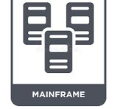
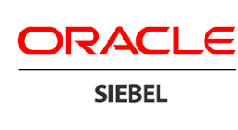
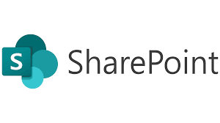
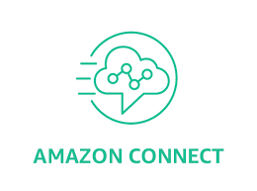
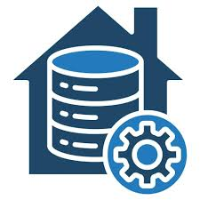
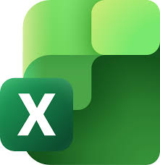

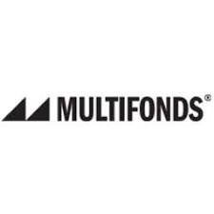


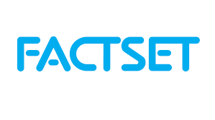

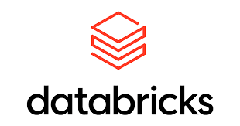


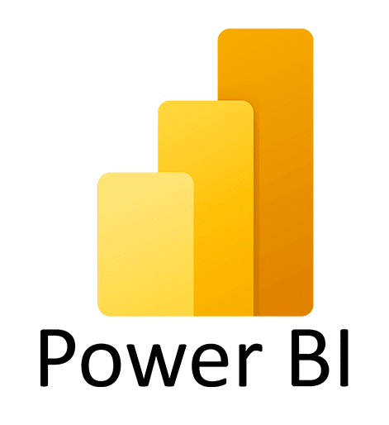
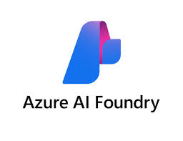

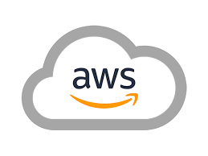
Recall: Canada Life’s Next-Gen Unified Data Platform for Insight, Innovation, & AI
A modern data foundation that standardizes how insights are created, shared, and operationalized at scale
Enterprise Sources
The Next-Gen Unified Data Platform
Enterprise Intelligence
NORTH
Canada Life
AI: Gen AI/ Agentic AI / ML
Data Repositories
Governed & High-Quality Data Products
Information Access Layer
Experience: Enterprise Applications & Omni-Channel
Business datamarts
Data Supply Chain
Insights: Self Serve Analytics
Lifeco Entities
Business Intelligence: Reporting
External
Governance, Security & Metadata
Structured Data | Transactional Data | Unstructured Data | Documents | Voice
*Note: Data sources & Enterprise Intelligence technologies are not exhaustive and may evolve

Slide 6
Platform NORTH Architecture Blueprints

Slide 7




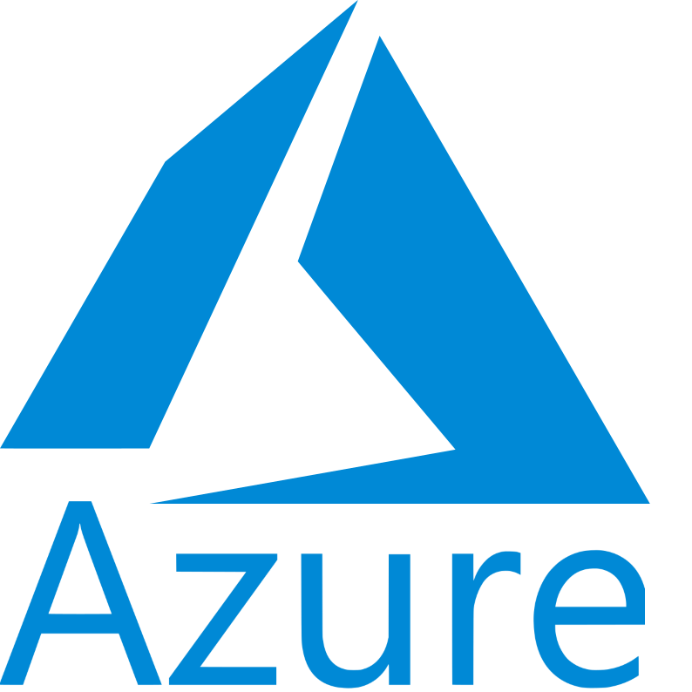
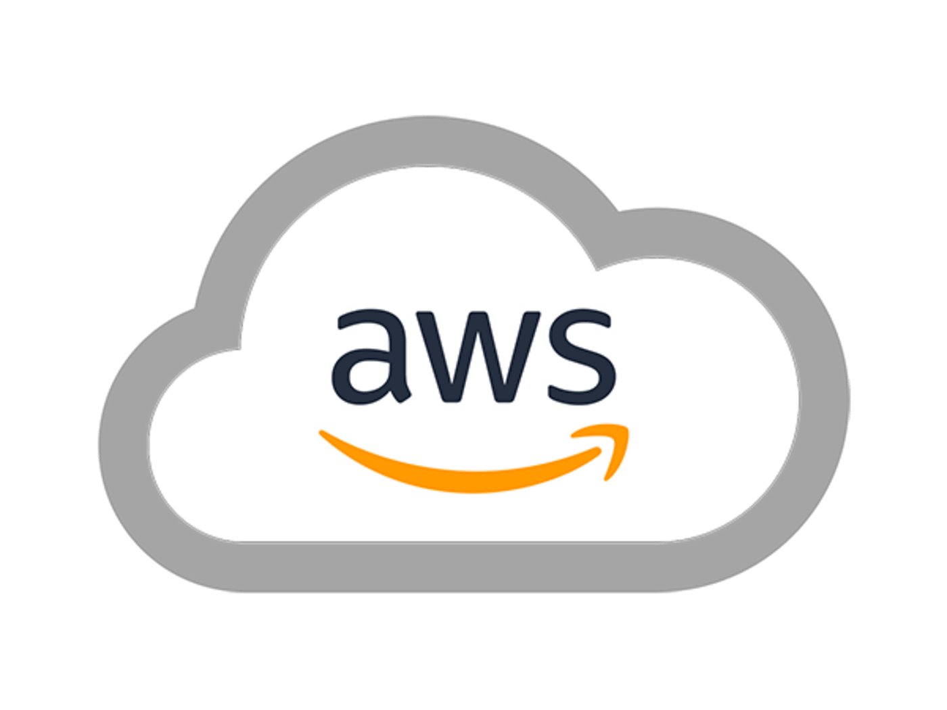
1.1 NORTH Data Platform: Functional Architecture
DATA SOURCES
1
NORTH PLATFORM
CONSUMPTION LAYER
Extendable/Contractable
Data Integration
Canada Life Data Nodes
Information Access
Business Units
2
Specialized Nodes
(Segregated data)
Self-Serve Analytic Tools
Query Federation & Virtualization
WBR
Wealth
…..
BU (N)
PSHCP
…………
Specialized Node (N)
Query Federation & Virtualization
API
Functional Areas
Reports / Dashboards
Corp Strategy
Canada Ops
…………
Functional Area (N)
Files (Batch)
Streaming
Applications
Enterprise Node (360 views)
Enterprise Node (N)
3
Pub / Sub
Structured Data (e.g. transactional data)
…………
Near Real Time
5
Tabular Views
ML Models
Global LifeCo. Functional Areas
Semi-structured Data (e.g. excel, logs)
Batch
Finance (Canada)
Finance (LifeCo)
Investment (Canada)
Investment
(LifeCo)
….
Functional Area (N) (Canada)
Functional
Area (N)
(LifeCo)
Graph
Master Data Management
AI Systems
Unstructured Data (e.g. documents, audio)
Database connection
Data Governance | Observability
4
Marketplace | Data Discoverability
Multi‑Cloud Platform Architecture
1
Enterprise data integration layer supporting structured & unstructured data with segment data platforms interoperability
3
Enterprise insights including 360 views created by connecting and reusing data across nodes
4
Enterprise portal for self-serve data within the NORTH platform
2
De-centralized creation of Business insight and AI-Ready data through standardized tools and patterns
5
Enterprise information access layer securely feeding data to support AI, analytics, and enterprise applications
Legend
Enterprise Data Capability
Business Unit / Functional Area Capabilities

Slide 8
1.2 NORTH Platform Data Node FAQ
Clarifying data ownership, accountability, and impact.
Why did we organize the North platform this way?
This is how Canada Life operates, funds (including chargeback), and sets accountability for its data.
Teams closest to the data own it end-to-end, enabling them to manage, improve, and share trusted data products while maintaining enterprise-wide consistency.
When an application contains data from multiple data domains, how do we decide which node the data should land in?
Data from a source application lands in the node of the business unit or functional area it primarily serves. Based on the Enterprise Architecture repository, our technology landscape has very few situations where an application will supply different nodes.
The North Platform is designed for data to be shared and accessed across nodes to satisfy business needs.
If there is a reorganization, how does that impact what has already been set up on the North platform?
The North platform is designed to be flexible. This means that if there is a need to reorganise nodes, it can be achieved.
Depending on the re-organization, it can be achieved by re-assigning data ownership to an existing data node, or the data can be split into separate nodes or merged into a new node if required.

Slide 9
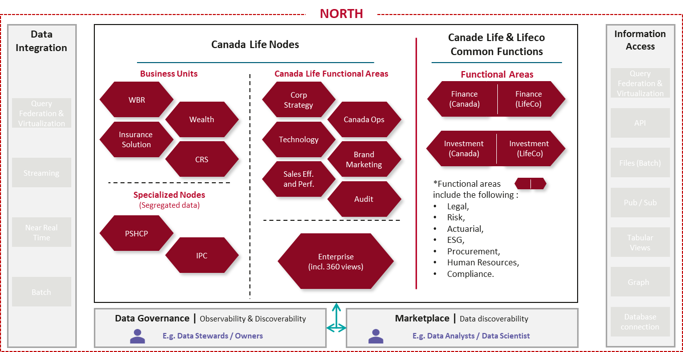


1.3. NORTH Data Node Blueprint
Each Node is a dedicated space where data is managed and shared for reuse within a Business Area and across the enterprise.
Node XYZ
Any nodes
Illustrative example
Path 1: Analytical Data
Node XYZ
Raw Data storage
Standardized Data storage
Curated Data Storage
Reporting and Classical AI
Bronze layer
(Data landing zone)
Silver layer
(Cleansed & conformed data)
Gold Layer
Curated data products for analytical use
The most common path of all. The preferred way for analytical needs, including Machine Learning. This path usually leverage tools such as PowerBI.
3 categories of data for complete coverage
Path 2: Operational Data
The following categories of data sets will follow either of the four path. Together, they form the construct of a Node in the North platform, ensuring that any business need can be satisfied.
Operational Data Store (ODS)
Standardized Data storage
Curated Operational Storage
Day-to-Day Operational Reporting and Applications
Bronze layer
(Low latency operational data)
Silver layer
(Cleansed & conformed data)
Gold Layer
Curated data products for operational usage
Low‑latency data to run operations and support real‑time decisions.
Structured Data
E.g. : Transactional database, datamart, structured flat files
Path 3: AI-Ready Data
Semi-structured Data
Raw Data storage
Standardized Data storage
Curated Data Storage
Generative AI and Agentic AI
E.g. : Excel, JSON, XML
Bronze layer
(Data landing zone)
Silver layer
(Embeddings)
Gold Layer
AI and search‑ready data products
Everything that you need to support generative AI and Agentic workflows. To be used when enterprise data needs to power AI products.
Unstructured Data
E.g. : Audio recordings, photos, unstructured flat files, word documents
Path 4: Pass-through for Un-structured Data
AI Search and Standard Copilots
Copilot
Leverage documents as-is. Used to feed tools like Microsoft Copilot and enterprise search.
SharePoint
Legend
Data Flow
Data Product-Trusted, governed data owned by business units
Notes:
Note:
Make the story telling cleaner
Add sharepoint logo

Slide 10
1.4. Shared Services and Connectivity: Accessing Data Products Across Nodes
The NORTH platform provides secure, standardized connectivity that enables teams to discover and access data products across business data nodes, supporting enterprise reuse without creating silos.
NORTH*
Illustrative example
How Cross-Nodes Data Sharing Works
Business Units Nodes
WBR
Information Access
Data is published by each business unit as governed data products
Each business unit creates and owns its data products with clear definitions and quality standards.
Why it matters: Ensures everyone is using the same trusted data, eliminating conflicting numbers.
Data products are made accessible through a shared information access layer
The NORTH platform provides a common layer where data products across nodes can be securely found and accessed.
Why it matters: Teams can easily find and use data beyond their own area to answer broader business questions.
Access is granted based on roles and policies
Users request access, and permissions are enforced consistently across all nodes using enterprise governance controls.
Why it matters: Enables secure, compliant data sharing without slowing down access.
Data is accessed and combined without duplication
Data products remain in their source nodes and are accessed through standardized methods (e.g., query), enabling cross-domain insights without moving or copying data.
Why it matters: Reduces duplication and speeds up access to real-time, reliable insights.
Premium
Business Units (N)
Query Federation & Virtualization
…………
Find · Trust- Use
API
without waiting on central IT
Functional Nodes
Corp Strategy
Files (Batch)
Prospect
Business
User
Data
Scientist
Functional Areas (N)
Pub/Sub
…………
Functional Analyst
App
Developer
Tabular Views
Enterprise Node (360 views)
Graphs
Risk Analyst
Business
Analyst
Enterprise Node (N)
…………
Database connection
Marketplace | Data discoverability
An End User will discover and find the right sets of data through the Marketplace.
E.g. Risk Analyst/ Data Scientist
*Note: Simplified representation of the North Platform. An End User can access and leverage data from single or multiple nodes according to roles and access policies.
Legend
Data Flow
Data Product-Trusted, governed data owned by business units
Business Personas
Technical Personas

Slide 11
1.5 “360 Views Blueprint”
360 views are assembled by combining mastered data from MDM with relevant business data nodes to support enterprise reuse and decision‑making.
Illustrative example
CIAM
Illustrative example
Canada Life Data Nodes
A human can be many things…
4
Business Units
Specialized Nodes
(Segregated data)
MDM
WBR
Wealth
…..
BU (N)
PSHCP
…………
Specialized Node (N)
WBR
Group Benefits (WBR)
Advisor / Agent / Broker
Dependent
Member / Participant
1
Match
Data source
Merge
Canada Life Functional Areas
De-duplicate
Functional Area (N)
Insurance Sol.
Insurance Solution
Advisor / Agent / Broker
Insured
Policyholder
Prospect
2
Enterprise Unique Identifier
3
Corp Strategy
Canada Ops
…………
MDM Repository
3
Data source
Enterprise Node (360 views)
Enterprise Node (N)
….
3
Wealth
Wealth
Account Holder / Joint Holder
Advisor / Agent / Broker
Household Member
Global LifeCo Functional Areas
Data source
Finance (Canada)
Finance (LifeCo)
Investment (Canada)
Investment
(LifeCo)
Functional Area (N) (Canada)
Functional
Area (N)
(LifeCo)
….
HR
Human Resources (HR)
Employee
Data source
1
Align and Consolidate Data (MDM): Data from multiple source systems is matched, de-duplicated, and consolidated in MDM to create consistent business-level records
Create a Single Enterprise Identifier: These business records are linked under one enterprise identifier, connecting all related data for the same entity (Human) across the organization.
Assemble the 360 View: The enterprise record is combined with data from across business units and functions to deliver a complete, consistent 360 view.
CIAM authenticates the human identity that anchors MDM's Enterprise Unique Identifier.
Other BU & Func.
Other BU and Functions
Annuitant
Beneficiary
Cedant, Etc.
2
Data source
3
… But they can all be used to generate a 360 View as needed
4
Different nomenclature (e.g. human, prospect) can point to the same definition (e.g. Dependent, policy holder, customer) and can create together the 360 View to satisfy a business or technical needs.
Legend
Enterprise ID flow
Business/Functional data flow

Slide 12
1.6. 360 Views — Illustrative Data Sourcing
360 views are assembled by combining mastered data from MDM with relevant business data nodes to support enterprise reuse and decision‑making.
Illustrative example
Canada Life Nodes
Business Domain
Data Sources
Claims
Business Units
Person-ID
Business Domain
2
Enterprise
(Including 360 Views)
Business Domain
Data Sources
Investment Portfolio
Person-ID
Claims
Customer 360
Person-ID
3
……
Business Domain
Person-ID
Claims
Downstream Consumers
Enterprise Applications
AI and Analytics Consumers
2
Other
Data Sources
HR/Employee
Person-ID
Person-ID
Investment Portfolio
Person-ID
Investment Portfolio
Enterprise-Person-ID
MDM
Person-ID
HR/Employee
1
Other Area
Match
2
About the 360 views
Merge
Person-ID
The MDM will be mastering the “Person-ID” from various data sources. As a result, an “Enterprise-Person-ID” will be generated.
De-duplicate
HR/Employee
1
2
Business Data will move from respective sources into their related nodes.
MDM Repository
The “Person-ID” & the “Enterprise-Person-ID” is used to fetch the data related to a person to satisfy business needs.
1
Enterprise-Person-ID
3
Note : Independently of how Canada Life BU evolve over time, the above representation will remain.
Legend
Enterprise/ Person ID flow
Business data flow
Curated Data flow
Data Product

Slide 13
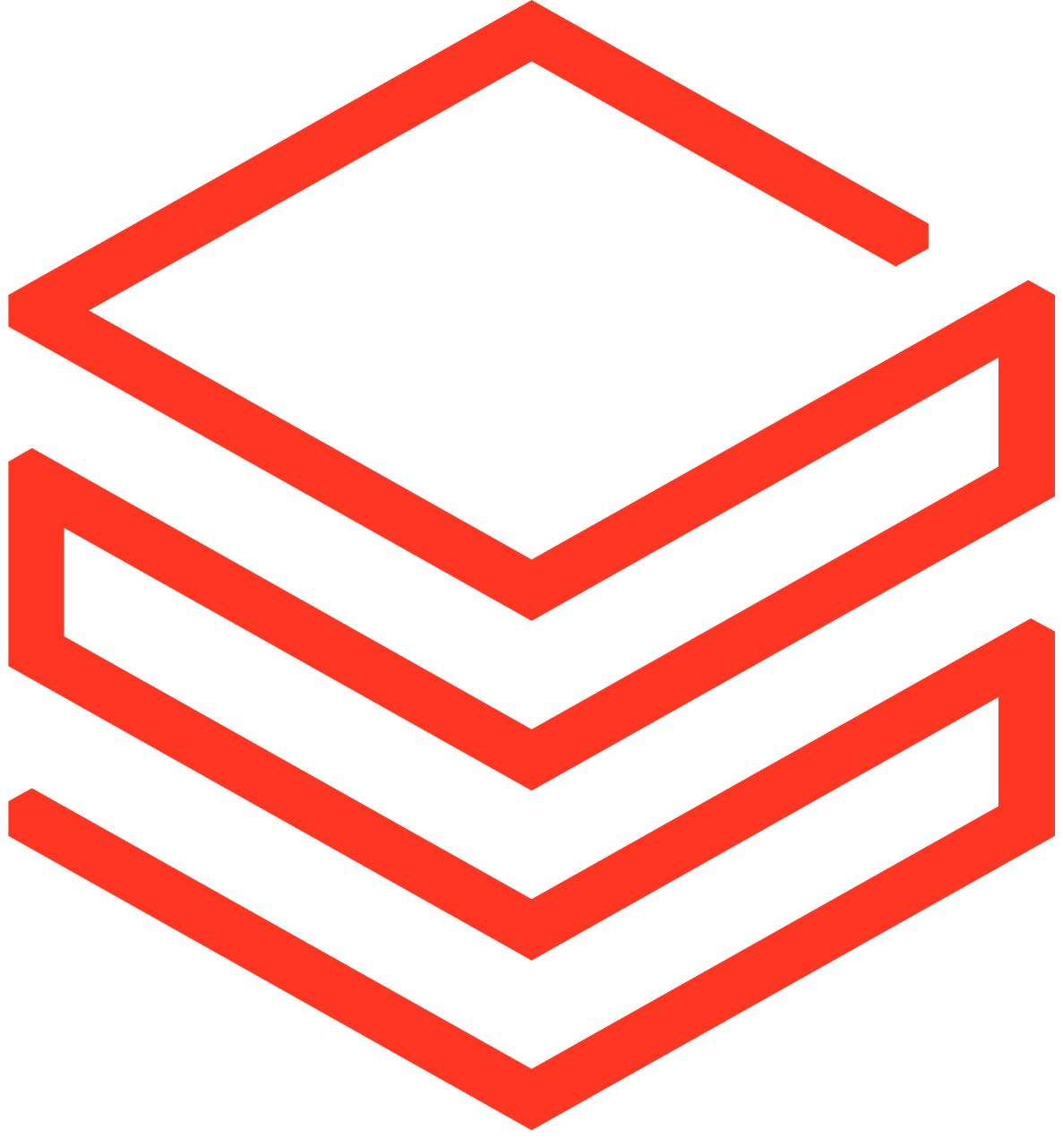
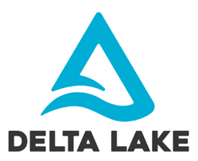



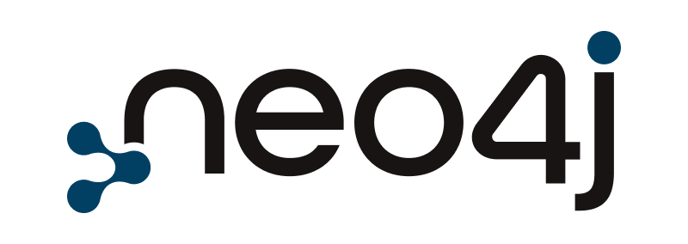

2.1 Business Data Node (Architecture-Oriented)
We support four ways to store and prepare data, each built for a different type of use case
Node XYZ
Reporting and Classical AI
Illustrative example
Used by analysts, data scientists and finance teams
Using Power BI, Tableau and ML pipelines
Used when data needs to be batch processed or modelled
Because reports and models break on incomplete or dirty data
Structured Data
Analytical Data
Transactional database, datamart, structured flat files
Raw Data storage
Standardized Data storage
Curated Data Storage
Has a defined, stable schema
Optimized for querying and reporting
Supports dashboards, operational apps, and classical AI
Bronze layer
(Data landing zone)
Silver layer
(Cleansed & conformed data)
Gold Layer
Curated data products for analytical use
Day-to-Day Operational Reporting and Applications
Operational Data
Used by operations, customer service and supply chain
Using live applications and real-time dashboards
Used when decisions can't wait
Because operational and analytical workloads must not compete
Semi-structured Data
Operational Data Store (ODS)
Standardized Data storage
Curated Operational Storage
JSON, unstructured flat files, Excel
Lakebase (postgres)
Lacks a rigid or consistent schema
Often event-driven, log-based, or machine-generated
Requires transformation, enrichment, or embedding before use
Bronze layer
(Low latency operational data)
Silver layer
(Cleansed & conformed data)
Gold Layer
Curated data products for operational usage
SQL
Generative AI and Agentic AI
AI-Ready Data (Unstructured)
Used by AI engineers and product teams
Using RAG pipelines, AI assistants and autonomous agents
Used when enterprise data needs to power AI products
Because LLMs need vectors and embeddings, not tables
Raw Data storage
Standardized Data storage
Curated Data Storage
Unstructured Data
Bronze layer
(Data landing zone)
Silver layer
(Embeddings)
Gold Layer
AI and search‑ready data products
Lacks a rigid or consistent schema
Document-centric and human-authored
Examples: policies, SOPs, presentations, knowledge articles
May require transformation, enrichment, or embedding before use
AI Search and Standard Copilots
Azure AI Search
No transformation is required, document used as-is where content just needs to be made available
Used to feed tools like Microsoft Copilot and enterprise search
Pass-through for Un-structured Data
SharePoint
Copilot
Persistent storage layer
Legend
Data Flow
Data Product
Notes:
Note:
Make the story telling cleaner
Add sharepoint logo

Slide 14

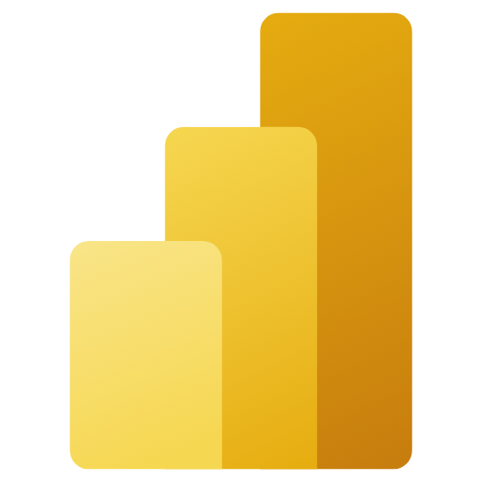





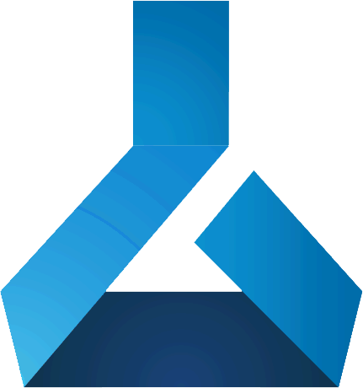
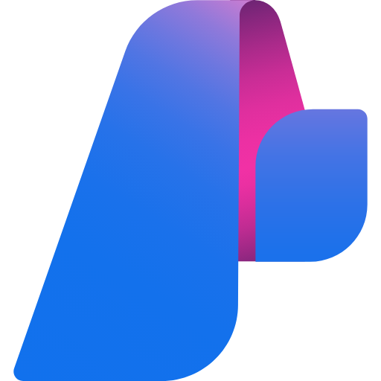
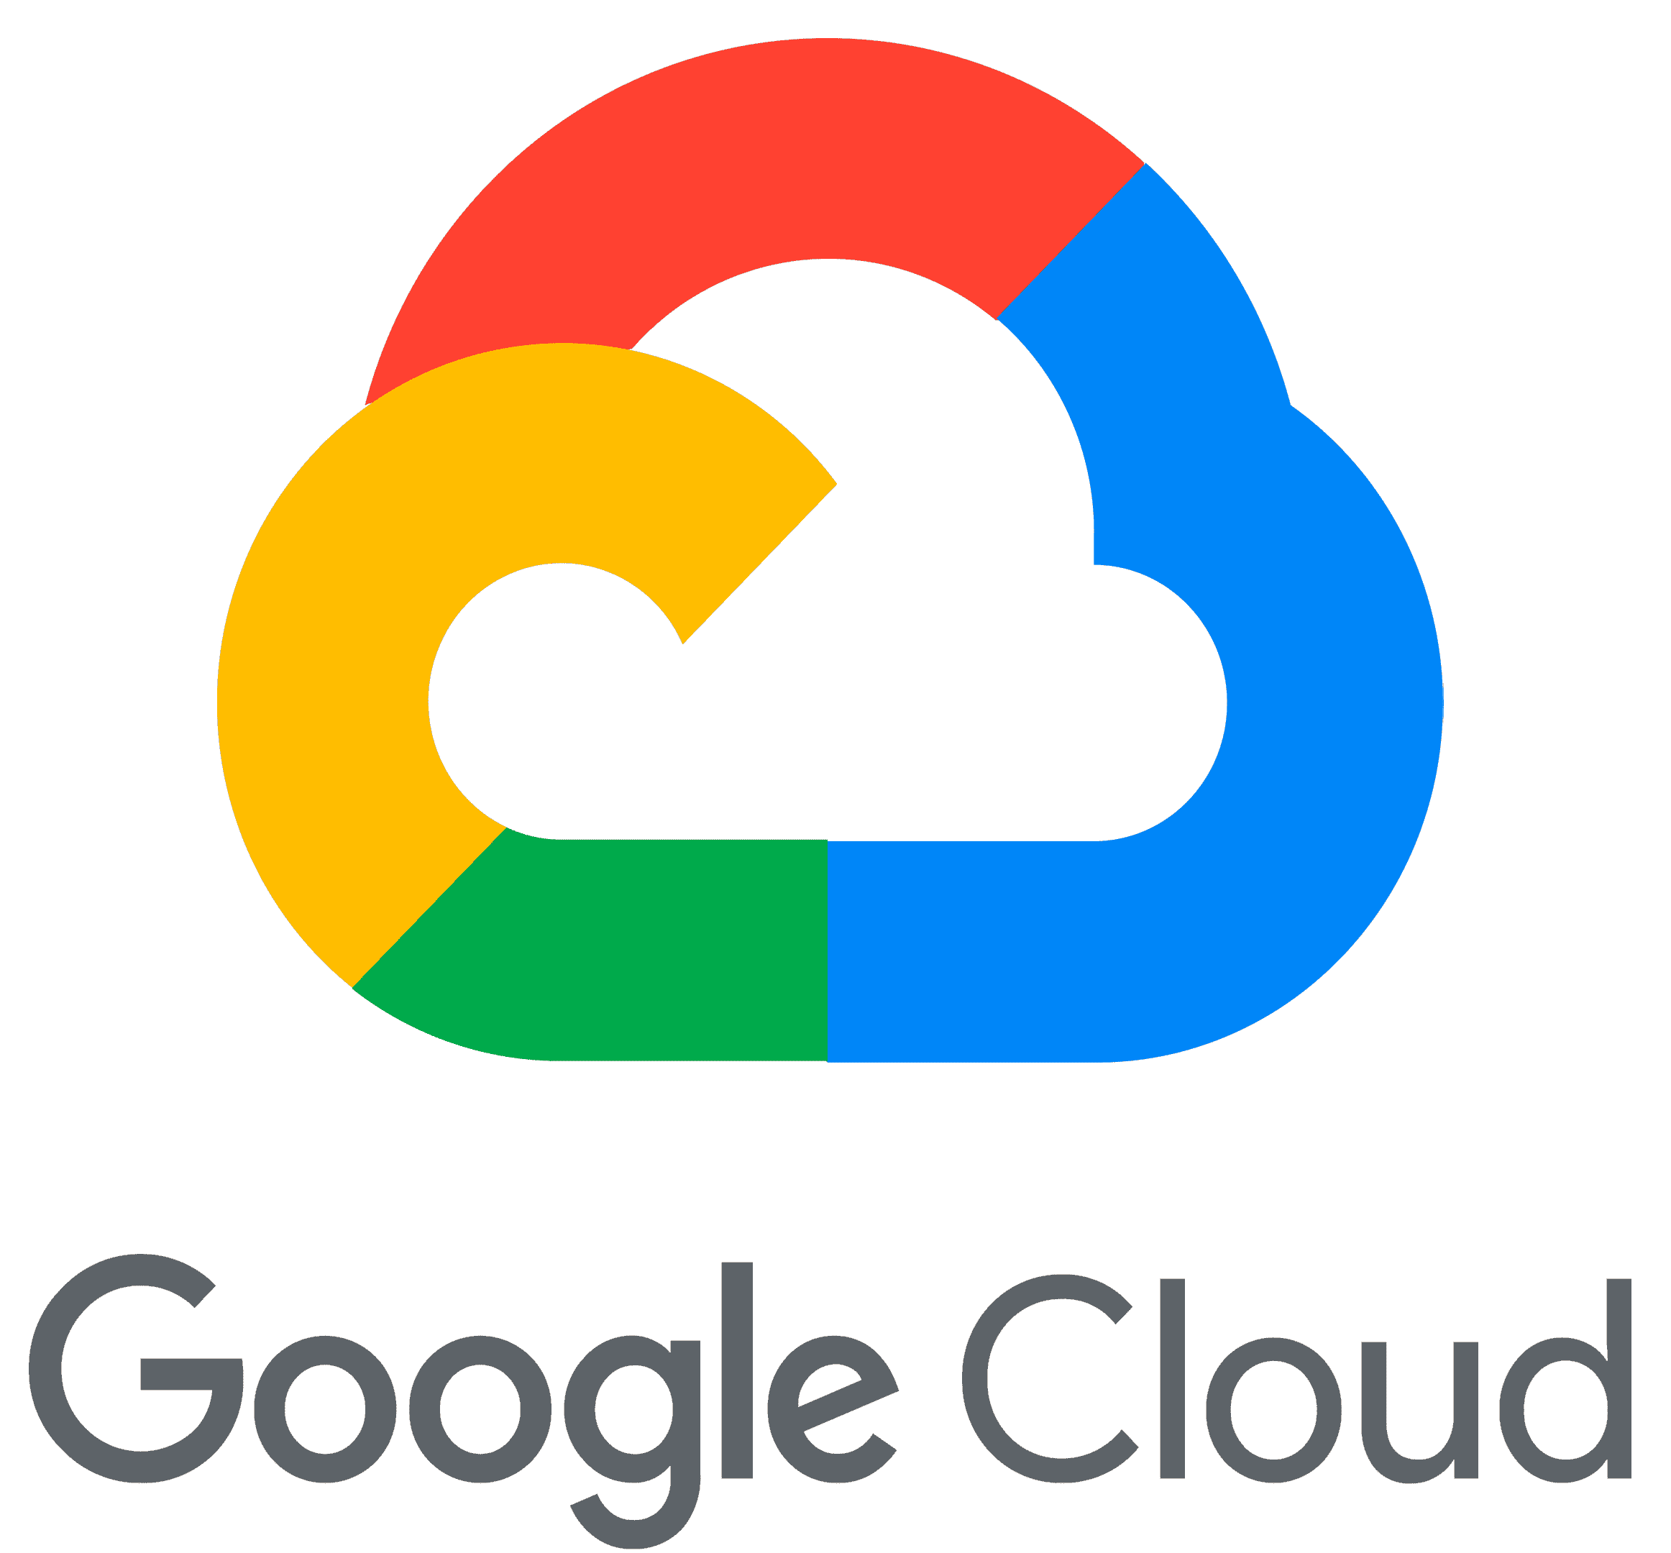
2.2 Multi‑Cloud Architecture Blueprint
Platform NORTH is Azure-first by design. The majority of the platform — ingestion, storage, analytics, and governance — runs on Azure. Select workloads run on AWS and GCP. The multi-cloud architecture is chosen for four reasons: resiliency, latency, performance, and specific functionality available in a particular cloud.
DATA SOURCES
NORTH Platform
Data Integration
Data Repositories (and Products) in Nodes
Data Information Access
Consumption Layer
Query Federation & Virtualization
Databricks
Query Federation & Virtualization
Analytical
API
Self-Serve Analytic Tools
Databricks
Databricks
APIM
Apigee
Power BI
Applications
Streaming
Files (Batch)
Applications
Kafka
Kafka
Informatica
Reports / Dashboards
Structured Data (e.g. transactional data)
Operational
Databricks
Power BI
RDS
Pub / Sub
Kafka
Kafka
ML Models
Near Real Time
Informatica
Semi-structured Data (e.g. excel, logs)
Apigee
SQL
Tabular Views
Azure ML
APIM
Databricks
Graphs
AI Systems
Microsoft Foundry
Unstructured Data (e.g. documents, audio)
AI-Ready Data
Neo4j
Batch
Database connection
Informatica
Cloud Service Providers
Azure AI Services
SQL
Databricks
RDS
Cloud Service Providers
Cloud Service Providers
Cloud Service Providers
Note : Apigee is the enterprise API Gateway standard running on GCP.
Legend
Data Flow

Slide 15
2.3 Shared Services and Connectivity: Cross-Region Data Product Access
Data from all regions flows into a single shared platform, with governance and access controls applied consistently across boundaries
NORTH Platform
Data Sources
Structured Data | Transactional Data | Unstructured Data | Documents | Voice | Video
Illustrative example
Canada Life Node
2
.
Finance (Canada)
Separate path established for Canada Life specific Data to avoid dependency with other segments
Canada Life
Raw Data storage
Standardized Data storage
Curated Data Storage
Sources
(e.g. Investment)
Bronze layer
(Data landing zone)
Silver layer
(Cleansed & conformed data)
Gold Layer
Curated data products for analytical use
CRS
Sources
(e.g COTS datamart)
Finance (LifeCo)*
* Default geographical region is Canada. Lifeco nodes can reside in different regions if needed to meet regulatory requirements.
Raw Data storage
Standardized Data storage
Curated Data Storage
Empower
Empower Data Platform
Bronze layer
(Data landing zone)
Silver layer
(Cleansed & conformed data)
Gold Layer
Curated data products for analytical use
1
Preferred method of ingesting cross segment data into NORTH is via Query Federation with the segment’s Data Platforms unless technically not feasible.
Europe
Europe Data Platform
GDPR/
Data Residency
Consent
Management
Policy
Enforcement
Identity and
Access Control
Legend
LifeCo.
Data Flow
Canada
Data Flow
Raw
Standardized
Curated
Consumers of Data
Notes:
Put in where MDM sits
Where lifeco sits in overall strategy

Slide 16
Enterprise Data Domains

Slide 17
3.1 Enterprise Information Model - Domains
All data across Canada Life is organized into 9 data domains with a shared business language to classify, govern, and align data across the enterprise
Party
Agreement
Product Shelf
A person, organization, or legal entity that participates in business activities (e.g., Customer, Advisor, Sponsor, Provider). Includes demographic attributes, consents, preferences, and contact methods.
Legally binding rights and obligations between parties. Includes policies, contracts, applications, and financial instruments.
The enterprise catalog of products and services that are offered, administered, or retired. Includes insurance, wealth, banking, and real estate products.
Event
Asset
Finance
Any interaction, transaction, or occurrence involving a party and/or agreement. Includes claims, payments, inquiries, incidents, and governance actions.
Tangible and intangible items of value, including securities, facilities, digital solutions, real estate, and vehicles.
Internal financial and accounting records, including general ledger, journals, reconciliations, solvency, and reserves.
Internal Organization Unit
Digital Identity
Reference Data
Enterprise organizational constructs, including structures, strategies, plans, policies, programs, campaigns, and business processes.
Authentication and Authorization information for internal and external users, including roles, permissions, and multi‑factor authentication details.
Standardized and governed reference data used across domains, including codes, statuses, languages, and payment methods.
Why establish Data Domains?
Creates a shared enterprise language: Core business concepts are defined once within domains and used consistently across products, channels, and systems.
Enables trusted, reusable insight at scale: Business‑owned domains support consistent reporting, analytics, and decision‑making across the enterprise.
Provides a stable foundation for governance and growth: Ownership, privacy, quality, and regulatory controls are anchored to domains, remaining stable as platforms and use cases evolve.

Slide 18
3.2 Person – Canada Life Ontology Model
A unified person model with a single canonical view of an individual across LOBs, with roles and relationships activated by context.
ROLES (1 person · many simultaneous roles)
Person
Advisor
Workforce
Customer
Beneficiary
Prospect
Member
Advisor
Contractor
Dependent
Claimant
Retiree
Investor
Broker
Employee
Trustee
Annuitant
Ceding Insurer
Policyholder
Organization
Insurance Solutions
Individual protection
Full Name
Date of Birth
Person ID
Plays role of
Contact
Plan Sponsor
WBR
Group benefits & retirement
belongs to
LOB
Products & Plans
Policies, Certificates, Accounts, Treaties
buys
PERSON
Universal entity · one record
works with/ works for
Vendor
Wealth
Investments & savings
Service Provider
enters via
Reinsurance
Risk transfer
CHANNEL (entry mechanism)
Individual · Group/Employer · Voluntary/Worksite · Direct/Digital · Broker/Advisor
Canada Life Org Unit
Legend
Root Entity
Roles
LOB
Channels
Organizational Relationships
Attributes
Note : Relationships shown in this diagram are not the exhaustive list of relations we have between entities

Slide 19
Enterprise Data Patterns

Slide 20
4.1 North Architecture Patterns
Architecture patterns are repeatable design standards that define how data in NORTH is: Ingested → Stored → Processed → Governed → Consumed
Core — Run the Platform
Cover the end-to-end data lifecycle
Enable trusted, governed data products
Support most business use cases across all domains
Required for reporting, analytics, and AI readiness
30
Extended
EXAMPLES
Data movement — batch, streaming, API
Platform foundation — Lakehouse, operational stores
Standard structured data pipelines
Governance — quality, metadata, security
Access and consumption — analytics and reporting
20
Core patterns
Extended — Scale & Innovate
Enable advanced and future-focused use cases
Improve operational efficiency and platform maturity
Applied selectively based on business needs
EXAMPLES
AI and machine learning pipelines
Unstructured data and document processing
Advanced governance and controls
Monitoring, automation, and cost management
New storage types — graph, vector databases
50 patterns total

Slide 21
4.2 North Platform Data Patterns
A summary view of how the 50 enterprise data patterns including 20 core and 30 extended patterns are distributed across the NORTH platform from ingestion to consumption.
Enterprise Sources
Next-Gen Organizational Repository for Trusted and High Value Data
Enterprise Intelligence
Data Integration
Data Repositories
Data Products
Information Access Layer
AI: Gen AI/ Agentic AI / ML
Canada Life
4 Data Patterns
Experience: Enterprise Applications & Omni-Channel
CRS
Data
Supply Chain
4 Data Patterns
7 Data Patterns
3 Data Patterns
7 Data Patterns
Insights: Self Serve Analytics
Empower
MDM & 360 views
2 Data Patterns
Business Intelligence: Reporting
Europe
Governance, Security & Metadata
19 Data Patterns
4 Data Patterns
Pattern Criteria
Complements Canada Life NORTH target Platform.
Spans the end‑to‑end data lifecycle, from ingestion to consumption.
Aligned to existing WDR journey and enterprise direction.
Highly reusable across domains, consumers, and strategic initiatives aligned with priority Business Outcomes.

Slide 22
4.3 Data Patterns – Inventory
A visual representation of 50 enterprise data patterns, including 20 core and 30 extended patterns, mapped across all layers of the NORTH platform.
Data Repositories
Data Products
Information Access Layer
Enterprise Intelligence
Lakehouse | ODS (operational Data Store)
Graph DB | Vector DB
Structured Data Products (Analytical & Operational)
Synthetic Data Products
Unstructured Data Products
Data Integration
Database Access
Internal Data Marketplace
Virtualization & Federation
API / Batch / Streaming / CDC Access
External Data Monetization
Graph Models
Search & Vectorized Access
Reporting & Analytics
AI & ML Consumption
Operational Applications
Self-Service Tools
Batch Data Movement
Streaming Data Movement
CDC
API
Data Supply Chain
Medallion Architecture | Incremental vs full processing
Streaming vs batch transformations
Masking & Anonymization | Synthetic Data Generation
Text Extraction / OCR | Vectorization, Content Enrichment & Chunking
MDM
MDM | 360 Views
Governance, Security & Metadata
Technical & Business Metadata | Data Quality | Ownership & Stewardship Model | Data Catalogue & Marketplace | Data Contracts | Common Information Model
DataOps & CI/CD | Support Models | Cost Management & FinOps | Versioning | Data Classification & Protection | Fine-grained Access Control | Policy Enforcement Pattern
Monitoring | Lifecycle Management | Alerting | Observability (SLAs, Anomalies) | Audit, Retention & Disposition | Consent & Purpose-based Usage
Legend
  Prioritized Core Patterns
Core Patterns
Extended Patterns

Slide 23
Appendix

Slide 24
Enterprise 360 Views – Master Data and Architecture Perspective
Logical Hierarchy, Scope and Representation in Gold Layer
360 View | What It Is (Includes) | What It Is Not (Excludes) | Notes / Gold Layer Architecture
Party 360 | A complete view of all entities that interact with the enterprise, including individuals and organizations such as employees, advisors, service providers, beneficiaries, prospects, and partners. | Narrow views limited to a single role, entity type, or business context. | Serves as the authoritative master record in the gold layer; acts as the central hub from which all other 360 views are derived.
Human / Person 360 | A consolidated view of individual people, including employees, members or participants, beneficiaries, advisors, and prospects. | Legal entities, organizations, or corporate structures. | A derived view from Party 360; may include enriched attributes such as identity, compliance, and HR‑related information.
Organization / Org 360 | A consolidated view of structured legal entities such as employers, sponsors, advisor firms, and partner organizations. | Individual people, dependents, or employee‑specific records. | A derived view from Party 360; captures organizational hierarchies and inter‑entity relationships.
Customer 360 | Parties—individuals or organizations—that generate revenue for the enterprise. | Non‑revenue roles such as employees, internal users, or advisors not acting in a customer capacity. | A purpose‑specific derived view focused on revenue and relationship management; supports commercial and marketing decisions.
Advisor 360 | Individuals or organizations acting as licensed intermediaries or professional advisors. | Parties with no advisory role, including employees or beneficiaries. | A derived view filtered from Party 360; supports sales enablement, distribution management, and regulatory oversight.
Sponsor 360 | Organizations that fund, sponsor, or administer plans or services. | Individuals or organizations without sponsorship responsibilities. | A derived view filtered from Party 360; supports plan governance, funding oversight, and financial controls.
Employee 360 | A comprehensive view of enterprise employees, including identity, roles, access, performance, and training. | External advisors, contractors, service providers, or beneficiaries. | A derived operational view from Party 360; supports HR operations, compliance, and workforce planning.
Service Provider 360 | External or networked service providers engaged by the enterprise. | Parties not delivering services to the organization. | A derived view filtered from Party 360; supports provider management, network operations, and quality oversight.
Beneficiary 360 | Individuals or parties receiving benefits under enterprise plans or programs. | Employees, sponsors, advisors, or unrelated organizations. | A derived view filtered from Party 360; supports benefit administration and regulatory compliance.
Member / Participant 360 | Individuals enrolled in enterprise programs or plans. | Non‑participants or individuals without active enrollment. | A derived view filtered from Party 360; supports participation tracking and program management.
Prospect 360 | Individuals or organizations identified for future engagement or conversion. | Existing customers, employees, or active advisors. | A derived view filtered from Party 360; supports marketing, sales pipeline, and growth initiatives.
Notes:
Single view i

Slide 25
Enterprise Data Principles

Slide 26
1. Canada Life Data Principles – Framework
A unified framework guiding how data is created, governed, and used across the enterprise
The 4 Data Principles Pillars
The following represent the four pillars which the North Platform will build and govern upon.
Business / Strategic Principles
Trust, Governance & Security Principles
Platform Architecture Principles
Execution Principles
Define what must be true for data to deliver business value, accountability, and leadership confidence.
Define what must be true for data to deliver business value, accountability, and leadership confidence.
Define what must be true in the data architecture to enable scale, reuse, interoperability, and secure data sharing.
Define what must be true in delivery and operations to ensure consistency, speed, quality, and control.
Why have Data Principles?
We organize principles into four pillars because delivering data at scale requires alignment across four enterprise directions: business value, trust/governance, architecture, and execution.
How Data Principles came to be?
Data principles originate from the need for change and the expected Business Outcomes of the North Platform. Having these Principles enable the platform to be designed and implemented with coherence while being aligned to what truly matter for Canada Life
Case for Change (Why act) → Business Outcomes (What success look like) → Principles (What must be true) → Patterns (How we design for it ) → Implementation (How we build it)

Slide 27
2. Canada Life Data Principles
Business principles define value, architecture principles enable scale, and execution principles ensure outcomes are delivered repeatedly and safely
Business / Strategic Principles | Trust, Governance & Security Principles | Platform Architecture Principles | Execution Principles
Define what must be true for data to deliver business value, accountability, and leadership confidence. | Define what must be true for data to remain trusted, compliant, protected, and controllable at scale. | Define what must be true in the data architecture to enable scale, reuse, interoperability, and secure data sharing. | Define what must be true in delivery and operations to ensure consistency, speed, quality, and control.
Unified Data Platform: All critical data required to enable decision making, automation, AI and business outcomes are made available through a unified, enterprise platform. Data as a product: Data is managed with clear owners, consumers, contracts, service expectations, and support. Data as a governed business asset: Every critical data product has accountable business ownership for meaning, quality, access, and lifecycle. Democratized data access: Provide timely, intuitive access to high-quality data so users can independently discover, understand, and act on insights. | Trust, security, and privacy by design: Privacy, security, regulatory compliance, and auditability are embedded as non-negotiable foundations. Least-privilege access: Access to production and sensitive data is restricted by default, granted based on role, purpose, and context, and fully auditable. Policy-driven automation: Governance policies are enforced automatically through platforms, pipelines, and controls. | AI-ready & machine-consumable data: Data is stored and enriched across structured and unstructured sources to enable analytics, automation, and AI at scale. Modular and Multi-Cloud: Architecture is modular and can operate across multiple hyperscalers to avoid unnecessary lock-in and remains adaptable across platforms and environments. Near real‑time data is the preferred: Batch processing used only where latency does not impact decisions or outcomes. Domain-oriented design: Data is structured using shared definitions and semantics aligned to business domains. Interoperable & composable: Data is built once and reused broadly across use cases, reducing duplication and increasing leverage. | Business-led & outcome-driven: Data initiatives are prioritized, funded, and measured based on measurable business outcomes, not technology upgrades. Incremental delivery: Data capabilities are delivered incrementally to accelerate value and learning. Product-oriented teams: Persistent, cross-functional teams own data products end-to-end through build, run, and improvement.

